Slide 1
Practice 7 - Improved DA analysis for RM

Slide 2
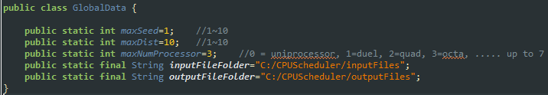
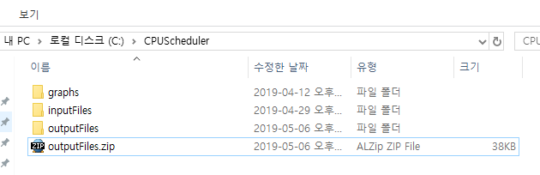
You should complete implementing
1) deadline-based analysis for any scheduling
2) “improved” deadline-based analysis for RM scheduling
in CPUScheduler V3_2
Follow the following steps
There should be file folders for input & output files in your PC; modify GlobalData.java and create the corresponding folders
Download outputFiles.zip from E-learning site, and unzip the file to your outputfile folder

Slide 3


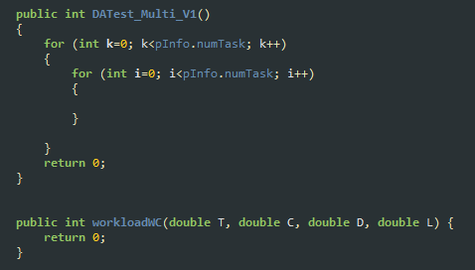
Create input files; run _Gen_Set.java
Complete “deadline-based analysis”; modify Analysis.java

Slide 4
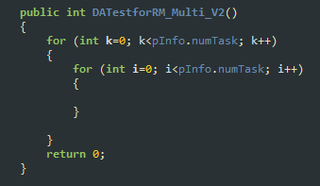
Complete “improved deadline-based analysis”; modify Analysis.java

Slide 5
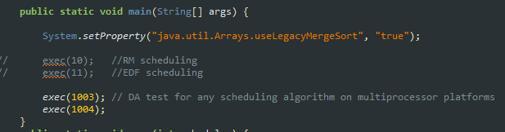
run _Exec_Set.java file; you don’t have to run for ’10’ and ‘11’

Slide 6
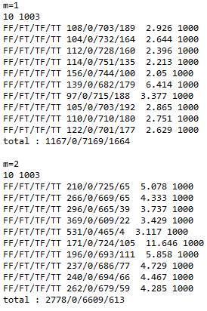
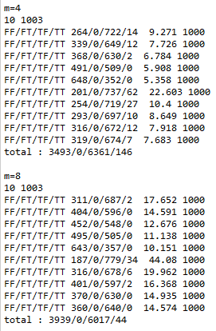
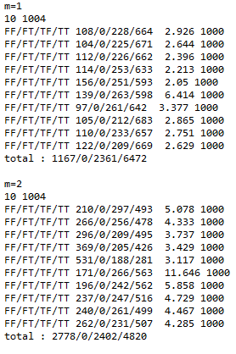
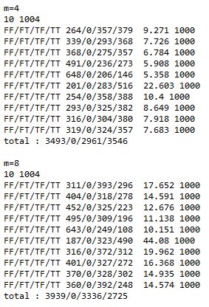
You see the following results by executing __ResultCompare.java

Slide 7
Schedulaiblity Analysis for Global Scheduling on Multiprocessor
Deadline-Based Analysis (DA analysis)
For any global preemptive scheduling (e.g., RM, EDF, etc.) on m identical multiprocessor
Underlying Idea
For each task τ_{κ}
check whether a job of τ_{κ} can complete its execution within D_{k} by calculating
I_{k}(D_{k}) = total interference suffered by task τ_{k} in interval of D_{k} and
the worst-case execution time C_{k}
τ_{k} is schedulable under any global scheduling if
C_{k}+I_{k}(D_{k}) ≤D_{k}

Slide 8

Schedulaiblity Analysis for Global Scheduling on Multiprocessor
Deadline-Based Analysis (DA analysis) – base idea
τ_{k} is schedulable under any global scheduling if
C_{k}+I_{k}(D_{k}) ≤D_{k}
execution of τ_{k}
execution of higher priority jobs
A job of τ_{k} is released here
$$\text{I}\text{k}\text{(}\text{Dk}\text{)}$$
m
t
t + D_{k}

Slide 9
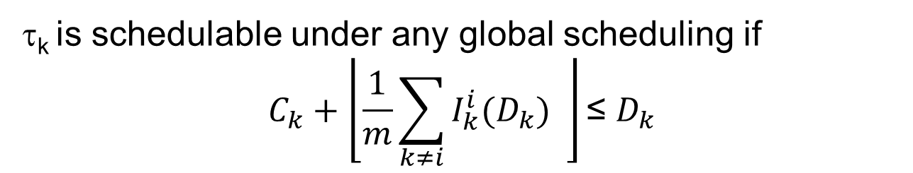
Schedulaiblity Analysis for Global Scheduling on Multiprocessor
Deadline-Based Analysis (DA analysis) – base idea
τ_{k} is schedulable under any global scheduling if
$$C_{k}+\left\lfloor \frac{1}{m}\sum_{k≠i}{I_{k}^{i}(D_{k})} \right\rfloor \text{≤} D_{k}$$
$I_{k}^{i}(D_{k})$= amount of execution of τ_{i} performed in D_{k}
A job of τ_{k} is released here
$$\text{I}\text{k}\text{(}\text{Dk}\text{)}$$
m
t
t + D_{k}

Slide 10
Schedulaiblity Analysis for Global Scheduling on Multiprocessor
Deadline-Based Analysis (DA analysis) – base idea
τ_{k} is schedulable under any global scheduling if
$$C_{k}+\left\lfloor \frac{1}{m}\sum_{k≠i}{I_{k}^{i}(D_{k})} \right\rfloor \text{≤} D_{k}$$
$I_{k}^{i}(D_{k})$= amount of execution of τ_{i} performed in D_{k}
A job of τ_{k} is released here
$$\text{I}\text{k}\text{(}\text{Dk}\text{)}$$
m
t
t + D_{k}

Slide 11
Schedulaiblity Analysis for Global Scheduling on Multiprocessor
The worst-case release pattern of τ_{i} maximizing $I_{k}^{i}\left(D_{k}\right)$
job release/deadline
execution
D_{k}
T_{i}
C_{i}
D_{i}

Slide 12
Schedulaiblity Analysis for Global Scheduling on Multiprocessor
The worst-case release pattern of τ_{i} maximizing $I_{k}^{i}\left(D_{k}\right)$
job release/deadline
execution
D_{k}
T_{i}
C_{i}
D_{i}

Slide 13
Schedulaiblity Analysis for Global Scheduling on Multiprocessor
The worst-case release pattern of τ_{i} maximizing $I_{k}^{i}\left(D_{k}\right)$
job release/deadline
execution
D_{k}
T_{i}
C_{i}
D_{i}

Slide 14
Schedulaiblity Analysis for Global Scheduling on Multiprocessor
The worst-case release pattern of τ_{i} maximizing $I_{k}^{i}\left(D_{k}\right)$
job release/deadline
execution
D_{k}
T_{i}
C_{i}
D_{i}

Slide 15
Schedulaiblity Analysis for Global Scheduling on Multiprocessor
The worst-case release pattern of τ_{i} maximizing $I_{k}^{i}\left(D_{k}\right)$
job release/deadline
execution
D_{k}
T_{i}
C_{i}
D_{i}

Slide 16
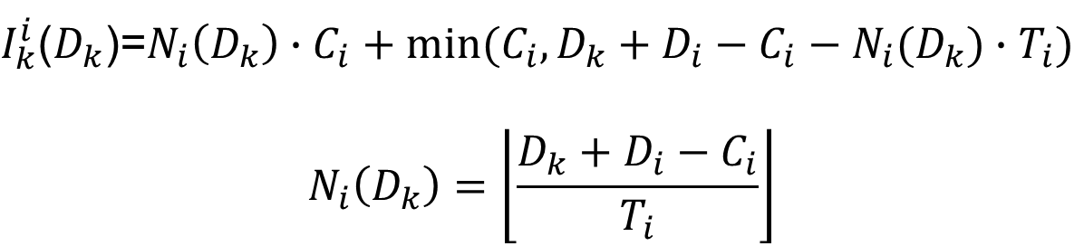
Schedulaiblity Analysis for Global Scheduling on Multiprocessor
The worst-case release pattern of τ_{i} maximizing $I_{k}^{i}\left(D_{k}\right)$
$I_{k}^{i}$($D_{k}$)=$N_{i}\left(D_{k}\right)∙C_{i}+min⁡(C_{i},D_{k}+D_{i}−C_{i}−N_{i}(D_{k})∙T_{i})$
$$N_{i}\left(D_{k}\right)=\left\lfloor \frac{D_{k}+D_{i}−C_{i}}{T_{i}}\right\rfloor$$
job release/deadline
execution
D_{k}
T_{i}
C_{i}
D_{i}

Slide 17
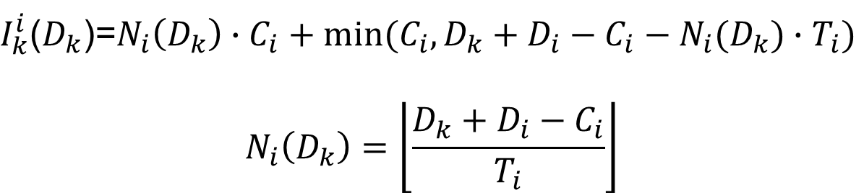
Schedulaiblity Analysis for Global Scheduling on Multiprocessor
Deadline-Based Analysis (DA analysis) – base idea
τ_{k} is schedulable under any global scheduling if
$$C_{k}+\left\lfloor \frac{1}{m}\sum_{k≠i}{I_{k}^{i}(D_{k})} \right\rfloor \text{≤} D_{k}$$
$I_{k}^{i}$($D_{k}$)=$N_{i}\left(D_{k}\right)∙C_{i}+min⁡(C_{i},D_{k}+D_{i}−C_{i}−N_{i}(D_{k})∙T_{i})$
$$N_{i}\left(D_{k}\right)=\left\lfloor \frac{D_{k}+D_{i}−C_{i}}{T_{i}}\right\rfloor$$
You should implement this in Analysis.java

Slide 18
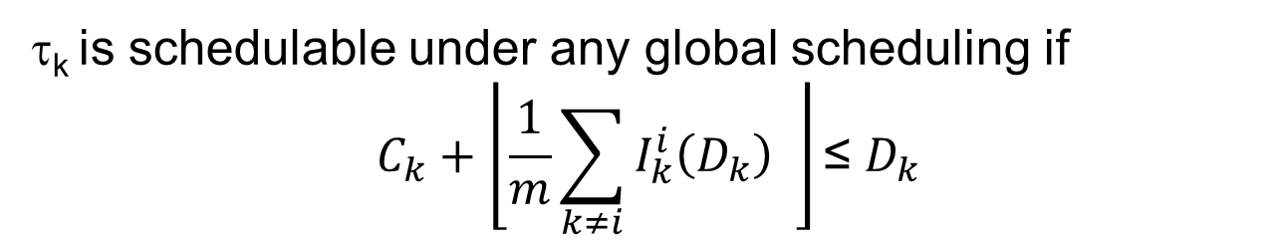



Pessimistic estimation of DA analysis
τ_{k} is schedulable under any global scheduling if
$$C_{k}+\left\lfloor \frac{1}{m}\sum_{k≠i}{I_{k}^{i}\left(D_{k}\right)} \right\rfloor \text{≤} D_{k}$$
$I_{k}^{i}(D_{k})$= amount of execution of τ_{i} performed in D_{k}
$$\text{I}\text{k}\text{(}\text{Dk}\text{)=5}$$
20
m=3
20
5
10
In reality
$\text{D}\text{k}$=20
In analysis
$$10+15 \text{>} 20$$

Slide 19
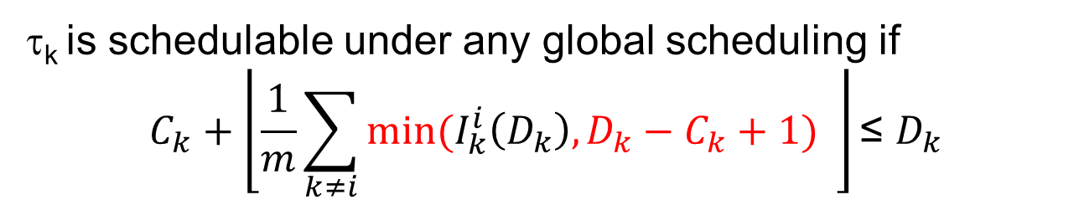



“Improved” deadline-Based Analysis (DA analysis)
τ_{k} is schedulable under any global scheduling if
$$C_{k}+\left\lfloor \frac{1}{m}\sum_{k≠i}{min⁡(I_{k}^{i}\left(D_{k}\right),D_{k}−C_{k}+1)} \right\rfloor \text{≤} D_{k}$$
$I_{k}^{i}(D_{k})$= amount of execution of τ_{i} performed in D_{k}
$\text{D}\text{k}\text{−}\text{Ck}$+1=11
20
m=3
20
5
10
$\text{D}\text{k}$=20
We focus on $"\text{D}\text{k}\text{−}\text{Ck}$+1” rather than $\text{D}\text{k}$

Slide 20
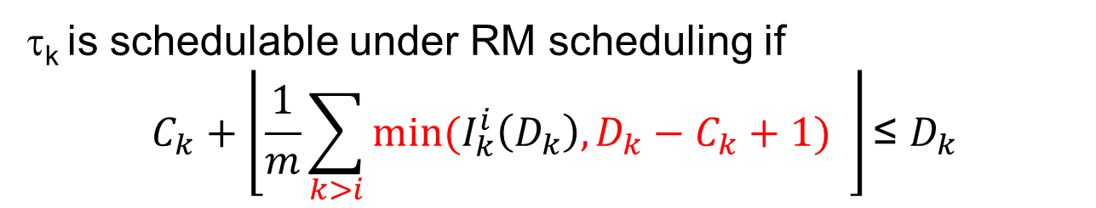
“Improved” deadline-Based Analysis (DA analysis) for RM
τ_{k} is schedulable under RM scheduling if
$$C_{k}+\left\lfloor \frac{1}{m}\sum_{k>i}{min⁡(I_{k}^{i}\left(D_{k}\right),D_{k}−C_{k}+1)} \right\rfloor \text{≤} D_{k}$$
$I_{k}^{i}(D_{k})$= amount of execution of τ_{i} performed in D_{k}
$\text{D}\text{k}\text{−}\text{Ck}$+1=11
20
m=3
20
5
10
$\text{D}\text{k}$=20
We ignore execution of lower priority jobs

Slide 21

“Improved” deadline-Based Analysis (DA analysis) for RM
τ_{k} is schedulable under RM scheduling if
$$C_{k}+\left\lfloor \frac{1}{m}\sum_{k>i}{min⁡(I_{k}^{i}\left(D_{k}\right),D_{k}−C_{k}+1)} \right\rfloor \text{≤} D_{k}$$
$I_{k}^{i}$($D_{k}$)=$N_{i}\left(D_{k}\right)∙C_{i}+min⁡(C_{i},D_{k}+D_{i}−C_{i}−N_{i}(D_{k})∙T_{i})$
$$N_{i}\left(D_{k}\right)=\left\lfloor \frac{D_{k}+D_{i}−C_{i}}{T_{i}}\right\rfloor$$
You should implement this in Analysis.java

Slide 22
You see the following results by executing __ResultCompare.java
1. First captured figure that should be submitted
2. Second captured figure that should be submitted

Slide 23
Practice 7 HW
Submission files
Analysis.java (yours)
Two captured output (in console window) figure; one that you saw in the previous slide
10 vs 1003
10 vs 1004
Description file(hwp or word file)
Firm deadline: refer to the E-learning site
No delay is allowed
Delayed submission is graded as 0
Wrong output(source code as well) is graded as 0
Duplicated (from other peers) source code is graded as 'F‘
You should explain how to implement your source code in our class

